Slide 1
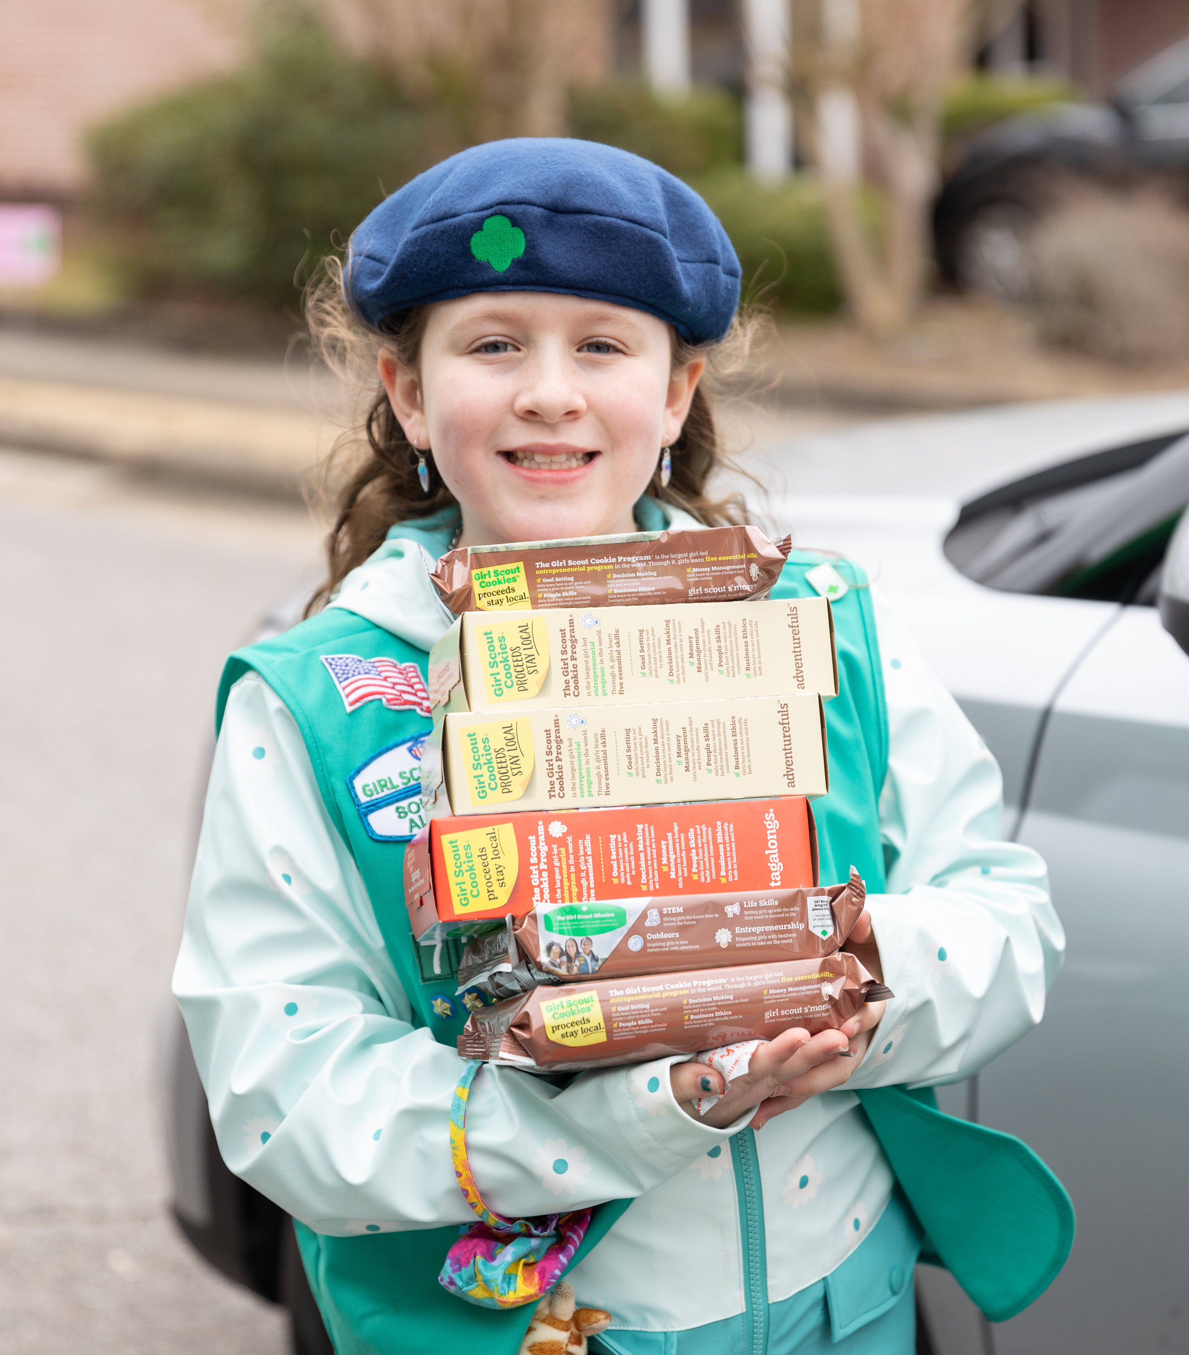

2023 Girl Scout Cookie
Program Caregiver Meeting

Slide 2
Permission/Agreement Forms
Important Reminders
Digital Cookie
Presales
Initial Orders
Troop Finances & Inventory Management
Hometown Heroes
Shipping Discounts
Ways to Sell Cookies
Benefits of Participation

Slide 3
Caregiver Meeting:
Girl Scout Cookie Program
Caregiver Permission/Agreement Forms
LINK

Slide 4
Caregiver Meeting:
Important Reminders
Girl Scout cookies in Alabama are $5 per package and can never be sold for any other amount.
Cookie booths, stands, and walkabouts may only take place in the 30 counties included in the Girl Scouts of Southern Alabama council area.
Cookie links can be shared with family and friends using personal social media pages, text, and email. Links cannot be shared on public sales sites, such as Facebook Marketplace, eBay or local buy/sell/trade pages (this list is not exhaustive).
Cookie links cannot be shared with television, print, or digital news media.

Slide 5
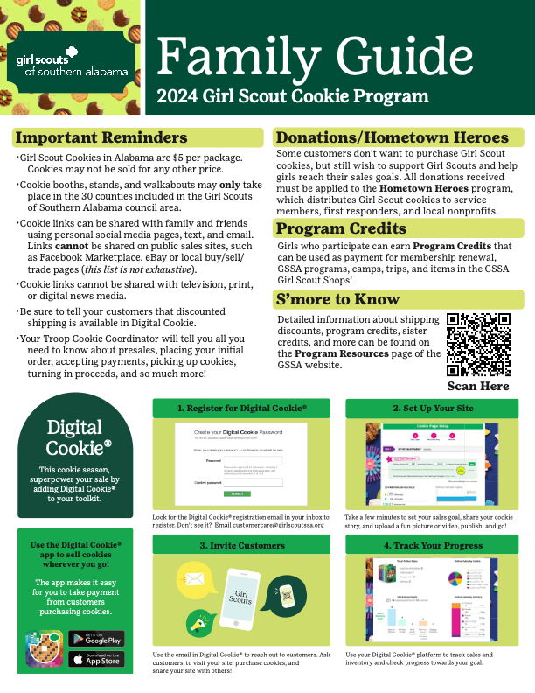
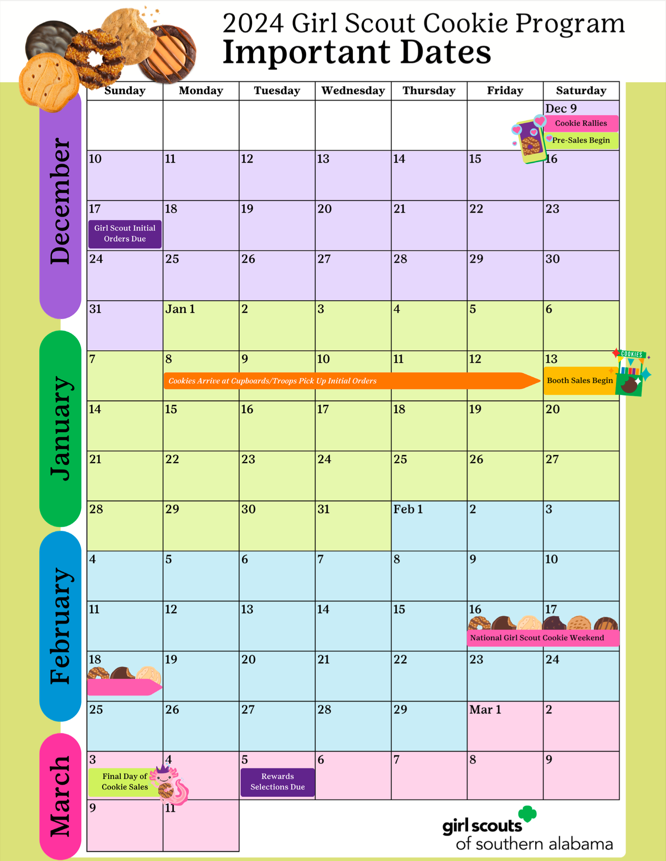
Caregiver Meeting:
Family Guide & Calendar
LINK

Slide 6

Caregiver Meeting:
Digital Cookie
You and your Girl Scout will manage her cookie sale using Digital Cookie from Girl Scouts of the USA.

Slide 7
Caregiver Meeting:
Digital Cookie
You will use Digital Cookie to:
Place Girl initial orders (by Dec 17)
Create a cookie link to share with friends and family
Receive orders for direct ship and girl delivery
Process credit card, Venmo & PayPal payments
Enter order card sales
Manage Inventory

Slide 8
Caregiver Meeting:
Digital Cookie
You will receive an email asking you to login and set up Digital Cookie
Watch these handy video and learn how to set up your site and navigate your dashboard:
Site Setup in Digital Cookie (VIDEO)
Caregiver Dashboard in Digital Cookie (VIDEO)

Slide 9
Caregiver Meeting:
Digital Cookie Resources for Families
Inventory by Category (VIDEO)
Delivery Settings (VIDEO)
Financials (VIDEO)
Rewards (VIDEO)
Digital Cookie in 4 Easy Steps (PDF)
Adjusting Delivery Settings (PDF)
Girl Scout and Caregiver (PDF)
Dashboard (PDF)
Mobile App Instructions (PDF)
My Account Tab (PDF)
More Cookie Resources Available for Cookie Sellers

Slide 10
Caregiver Meeting:
Presales
Pre-orders: Digital Cookie
  Customers can order cookies for direct-ship or girl-delivery
  Customers can pay with credit card, Venmo, or PayPal
Pre-Orders: Order Cards
  Customers will pay for their cookie order when it is delivered by Girl Scouts

Slide 11
Caregiver Meeting:
Initial Orders
At a minimum, Girl Initial Orders should include enough cookies to:
Fulfill all pre-order sales
Cover 1-2 weeks of in-person sales for each girl
Placing Girl Initial Orders:
You are financially liable for all cookies you receive
All initial orders should be placed in Digital Cookie by Sunday December 17
Cookies will not be distributed to families that have not returned the Caregiver Permission/Agreement form.
Placing Initial Order in Digital Cookie (VIDEO

Slide 12
How Many Cookies?
Guide
LINK

Slide 13
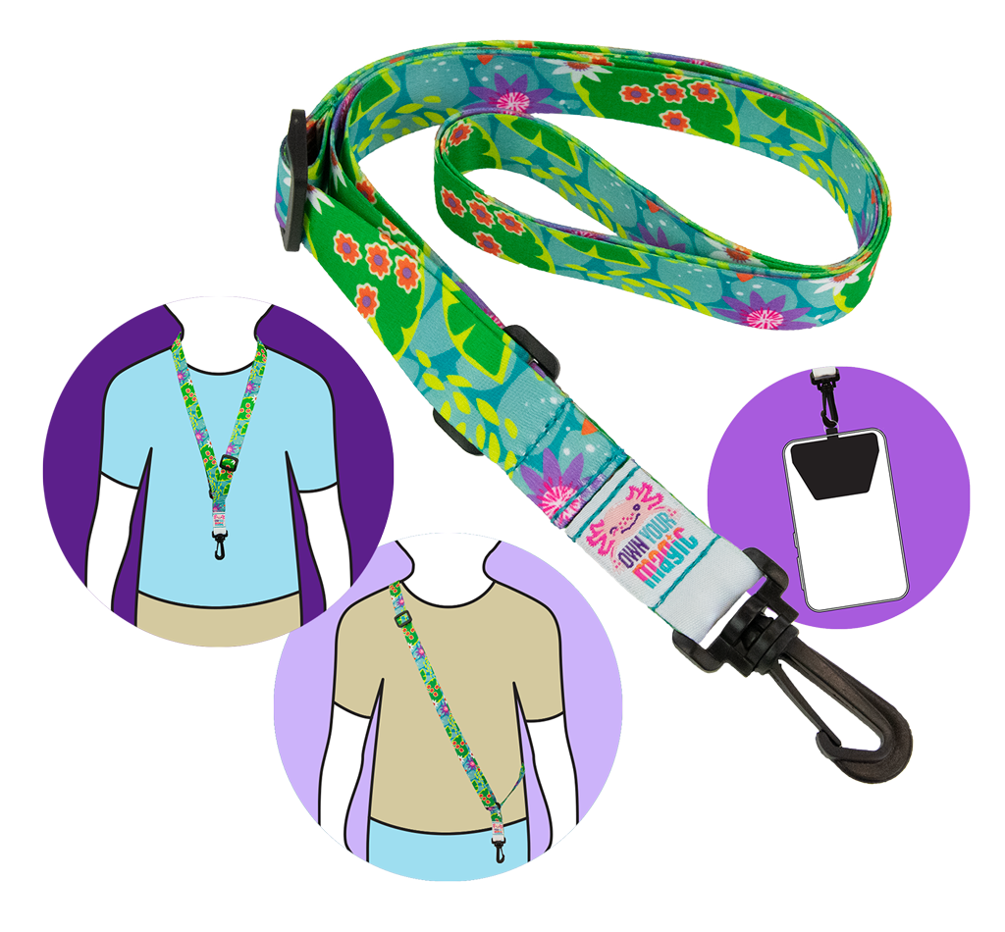
Caregiver Meeting:
Initial Orders
Girls that have Initial Orders of 250 packages (or more!) will receive an adjustable Own Your Magic lanyard!

Slide 14
Caregiver Meeting:
Troop Finances & Inventory Management
Troops determine the method and frequency of cookie pickups and caregiver payments.
Deposits should be made frequently.
Money will be collected for cookies in-hand before you are allowed to receive more.
If you have not complied with a payment deadline you will not receive more cookies.

Slide 15
Caregiver Meeting:
Hometown Heroes
Some customers don’t want to purchase Girl Scout Cookies, but still wish to support Girl Scouts and help girls reach their sales goals. All donations received must be applied to the Hometown Heroes program which distributes Girl Scout cookies to service members, first responders, and local non-profits.

Slide 16
Caregiver Meeting:
Shipping Discounts
GSSA will be discounting shipping for orders of up to 12 packages! The price breaks are:
4-12 Packages: $6.49
12+ Packages: No discount
  Customers that would like to order more than 12 packages will only receive discounted shipping if they place multiple orders of 4-12 packages.

Slide 17
Caregiver Meeting:
Ways to Sell Cookies
Walkabout
Friends and Family
Online
Troop Booths
Family Booths
Troop Drive-Thrus

Slide 18
Caregiver Meeting:
Cookie Etiquette
You are guests when you set up a cookie booth at a business location and should be on your best behavior.
Set up booth sale in the designated area. DO NOT block the entrance and follow the rules the business sets.
Be identifiable as a Girl Scout, and wear our Girl Scout Membership Pin, uniform, or other Girl Scout clothing.
Only approach customers as they are leaving the business and have a good attitude, smile, and say thank you even if a customer does not buy.
Adults must be present at all times. Don’t allow girls to wander around the location unchaperoned.
Don’t ask businesses for change.
Have your own table and hang signage on your table, not on the businesses’ property.

Slide 19
Caregiver Meeting:
Cookie Etiquette
RESPECT other troops’ sale time. Don’t set up early, and don’t stay after the allotted time. Resolve conflicts peacefully. DO NOT create a scene in front of a business!
Do not eat or drink during a booth sale (girls or adults).
An adult is responsible for money at all times. An adult watches or assists as the girls handle money. Keep money box in a safe place, especially during loading and unloading of cookies. DO NOT keep large amounts of money in the money box!
Make sure you count and write down the exact amount and flavor of boxes before beginning a booth sale. Then count the exact amount and flavor after the booth sale is over.
Clean up after booth sale and take ALL trash with you.
Park away from the front of the business, and do not take up their good parking spaces.
Do not use loud objects/devices to draw attention.

Slide 20
Caregiver Meeting:
Benefits to Participation
Baker Rewards
on the back of the order card
Notes:
-

Slide 21
Caregiver Meeting:
Benefits to Participation
Program Credits – program credits can be used as payment for membership renewal, GSSA Programs, camps, trips and items in the GSSA shops.
Sister Credits – allow multiple-Girl-Scout Households to combine the number of total packages sold and receive higher, accumulated Program Credits.
  Example: Sisters Sally & Sara
    Sally sells 250 packages, and Sara sells 250 packages. Combined, they can receive $50 Program Credits usually awarded at the 500 package level.
Please Note, this only applies to GSSA Program Credits - and NOT Rewards, provided by Little Brownie Bakers or the 800 Club Party.
Notes:
-

Slide 22
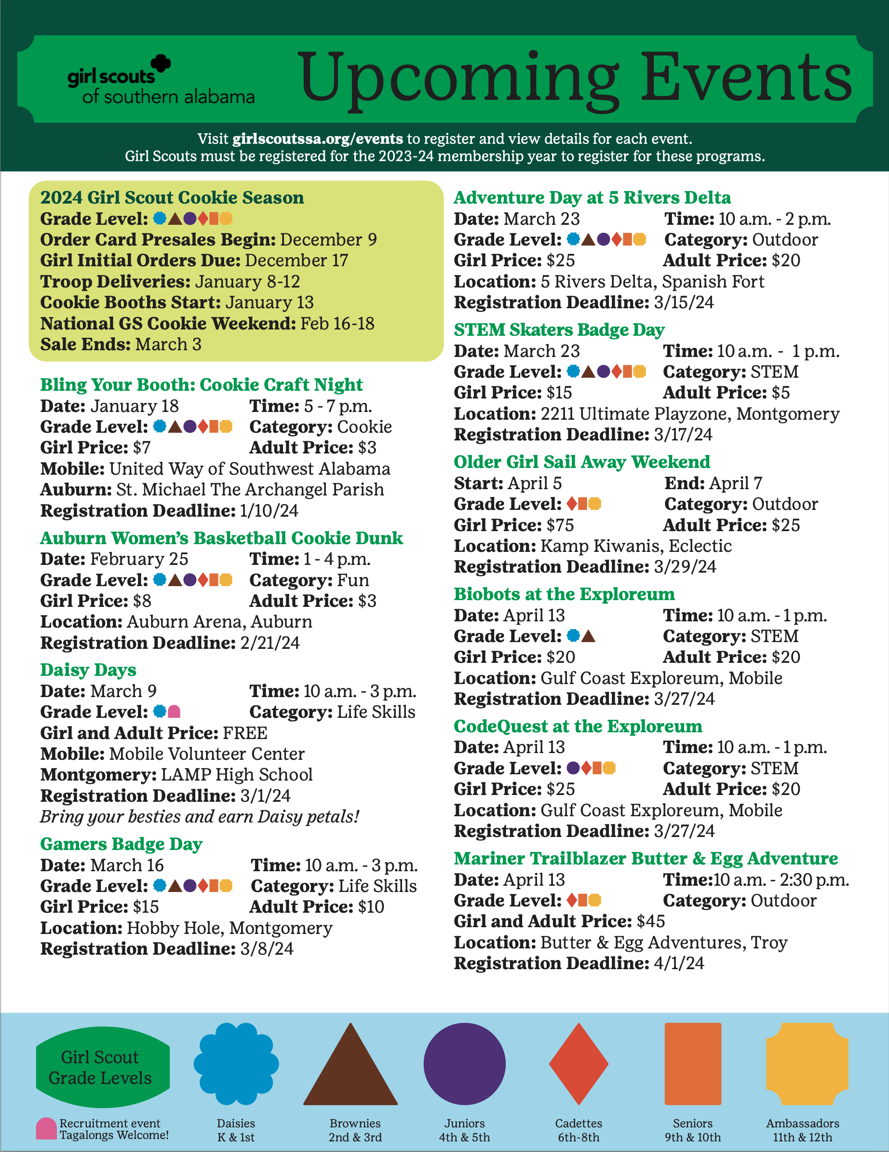
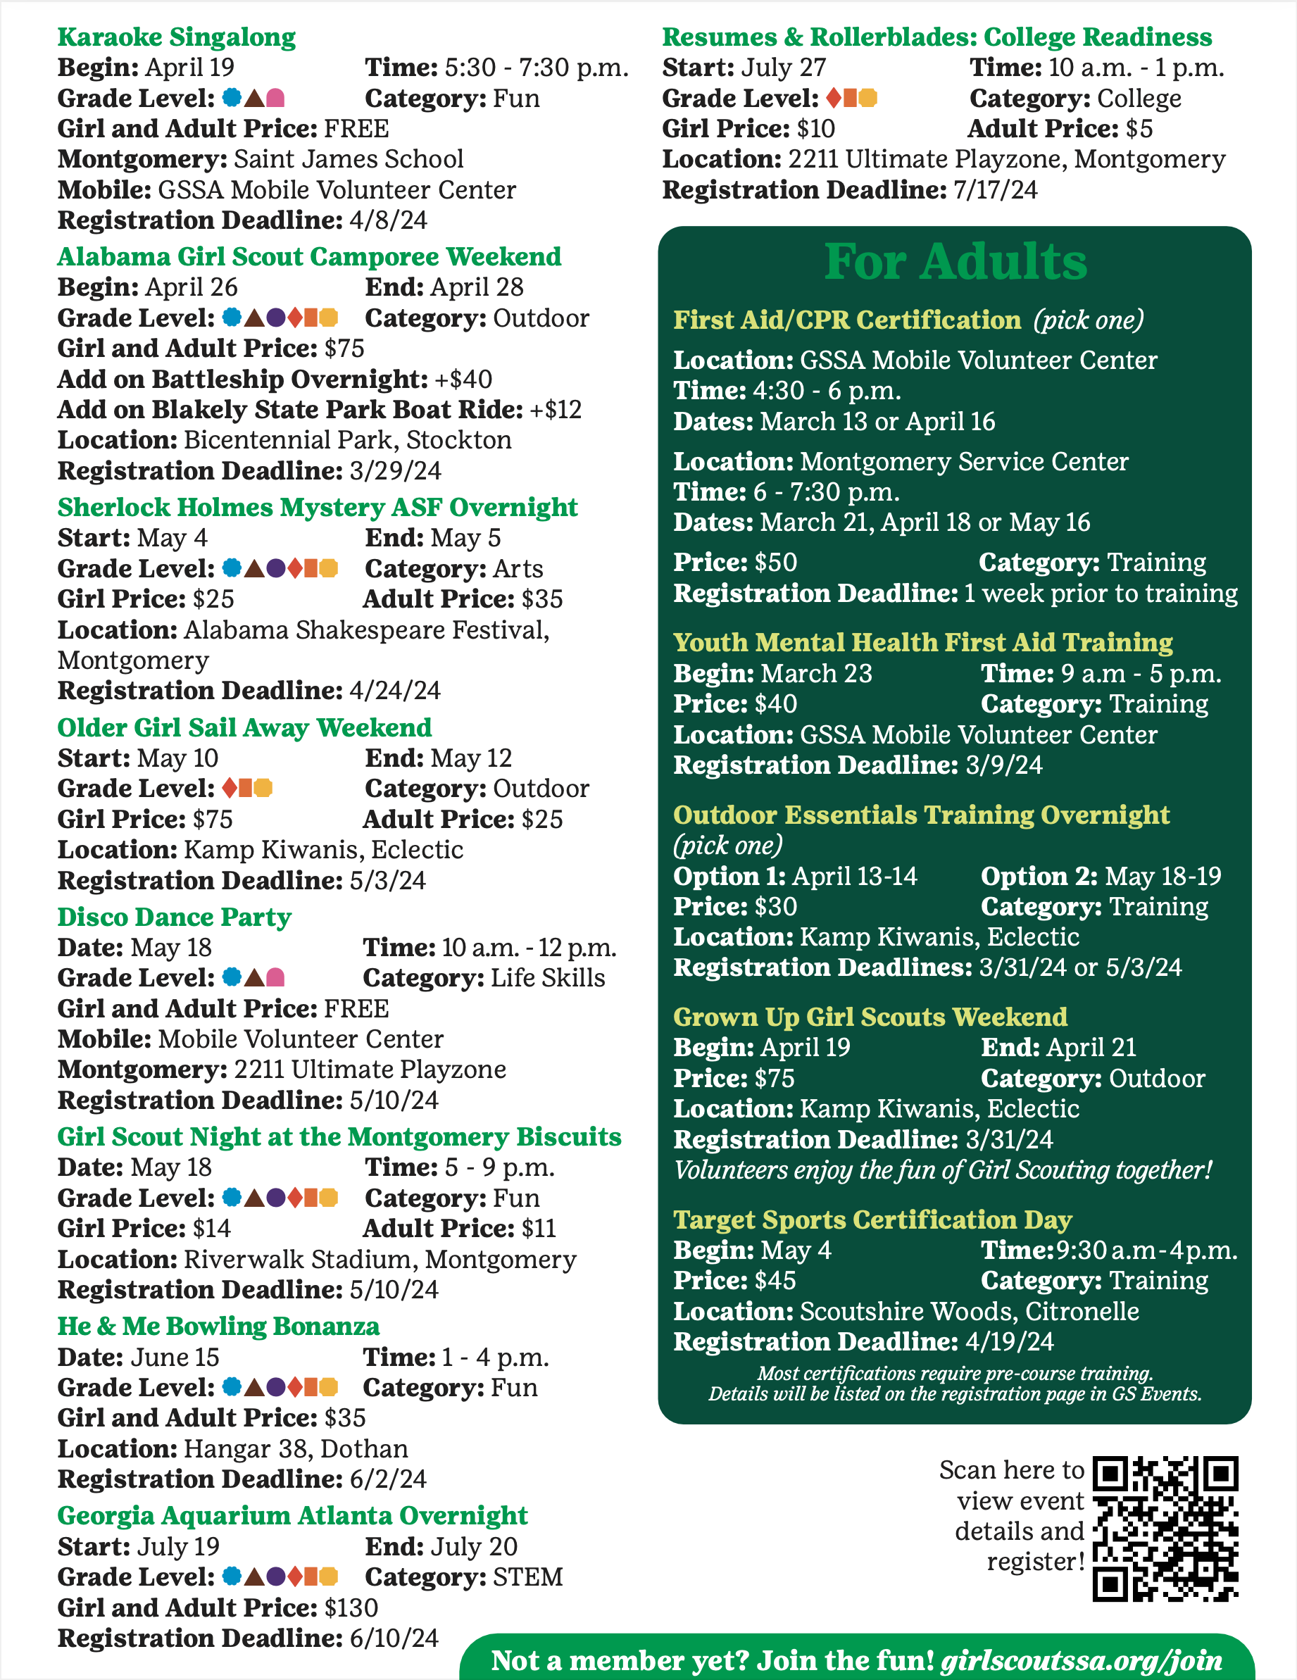


Spring 2024
GSSA Guide To Upcoming Programs
and Resident Camp Sessions

Slide 23

Travel to the Galapagos Islands | Summer 2025
Program Credits can be used towards travel.
GSSA is partnering with Girl Scouts of North Central Alabama and EF Tours to bring this amazing travel opportunity to Girl Scouts in Southern Alabama.
Learn More

Slide 24
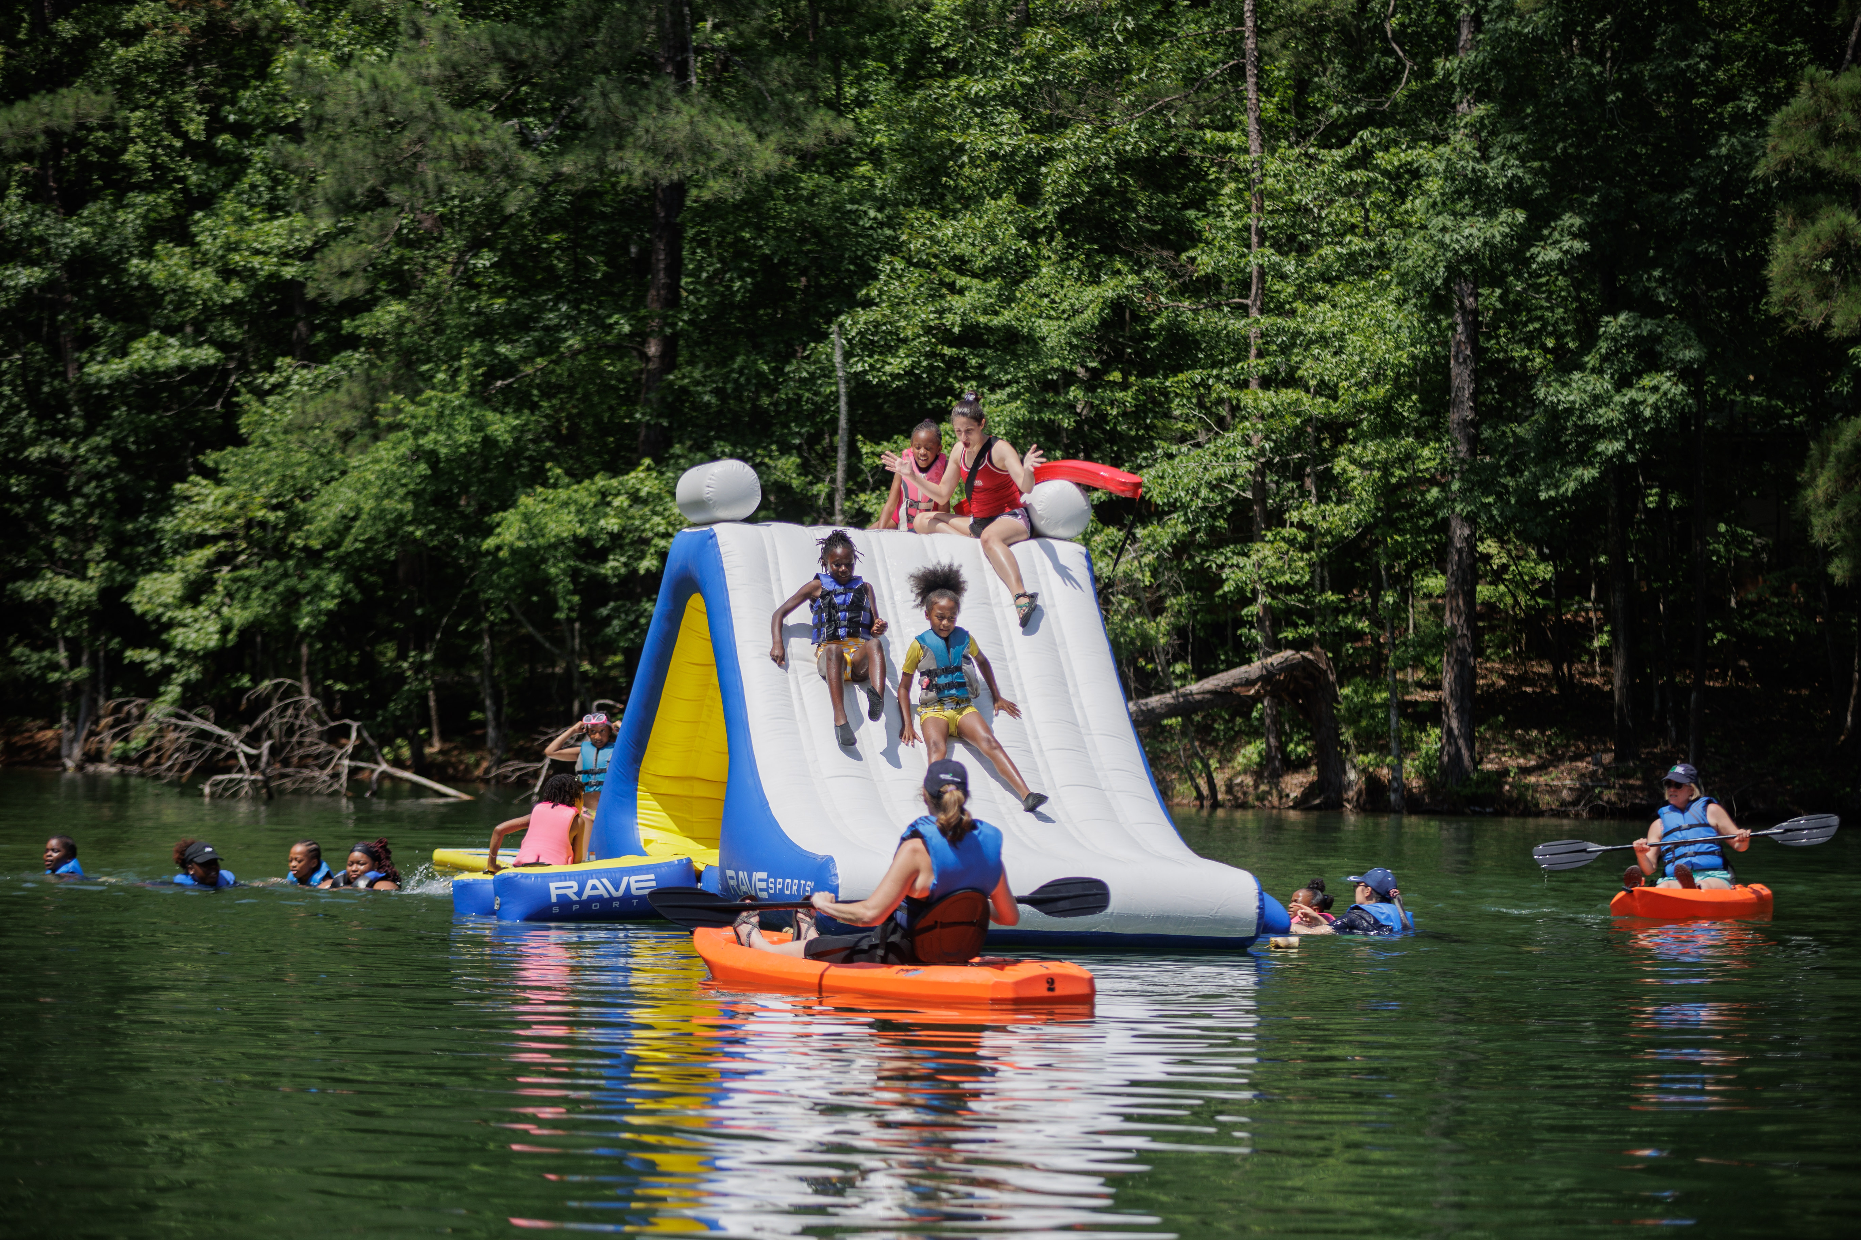
Caregiver Meeting:
Benefits to Participation
Cookie Discounts for Camp
250 pkg $50
400 pkg $75
500 pkg $100
Notes:
-

Slide 25
Caregiver Meeting:
Benefits to Participation
Troop Proceeds – highlight all the fun things your troop has planned!
Notes:
-

Slide 26
Questions
Questions during the sale? Email Customer Care!
customercare@girlscoutssa.org

Slide 27
Thank you!
Email Questions to CustomerCare@GirlScoutSSA.org

